Slide 1

Trailer

Slide 2

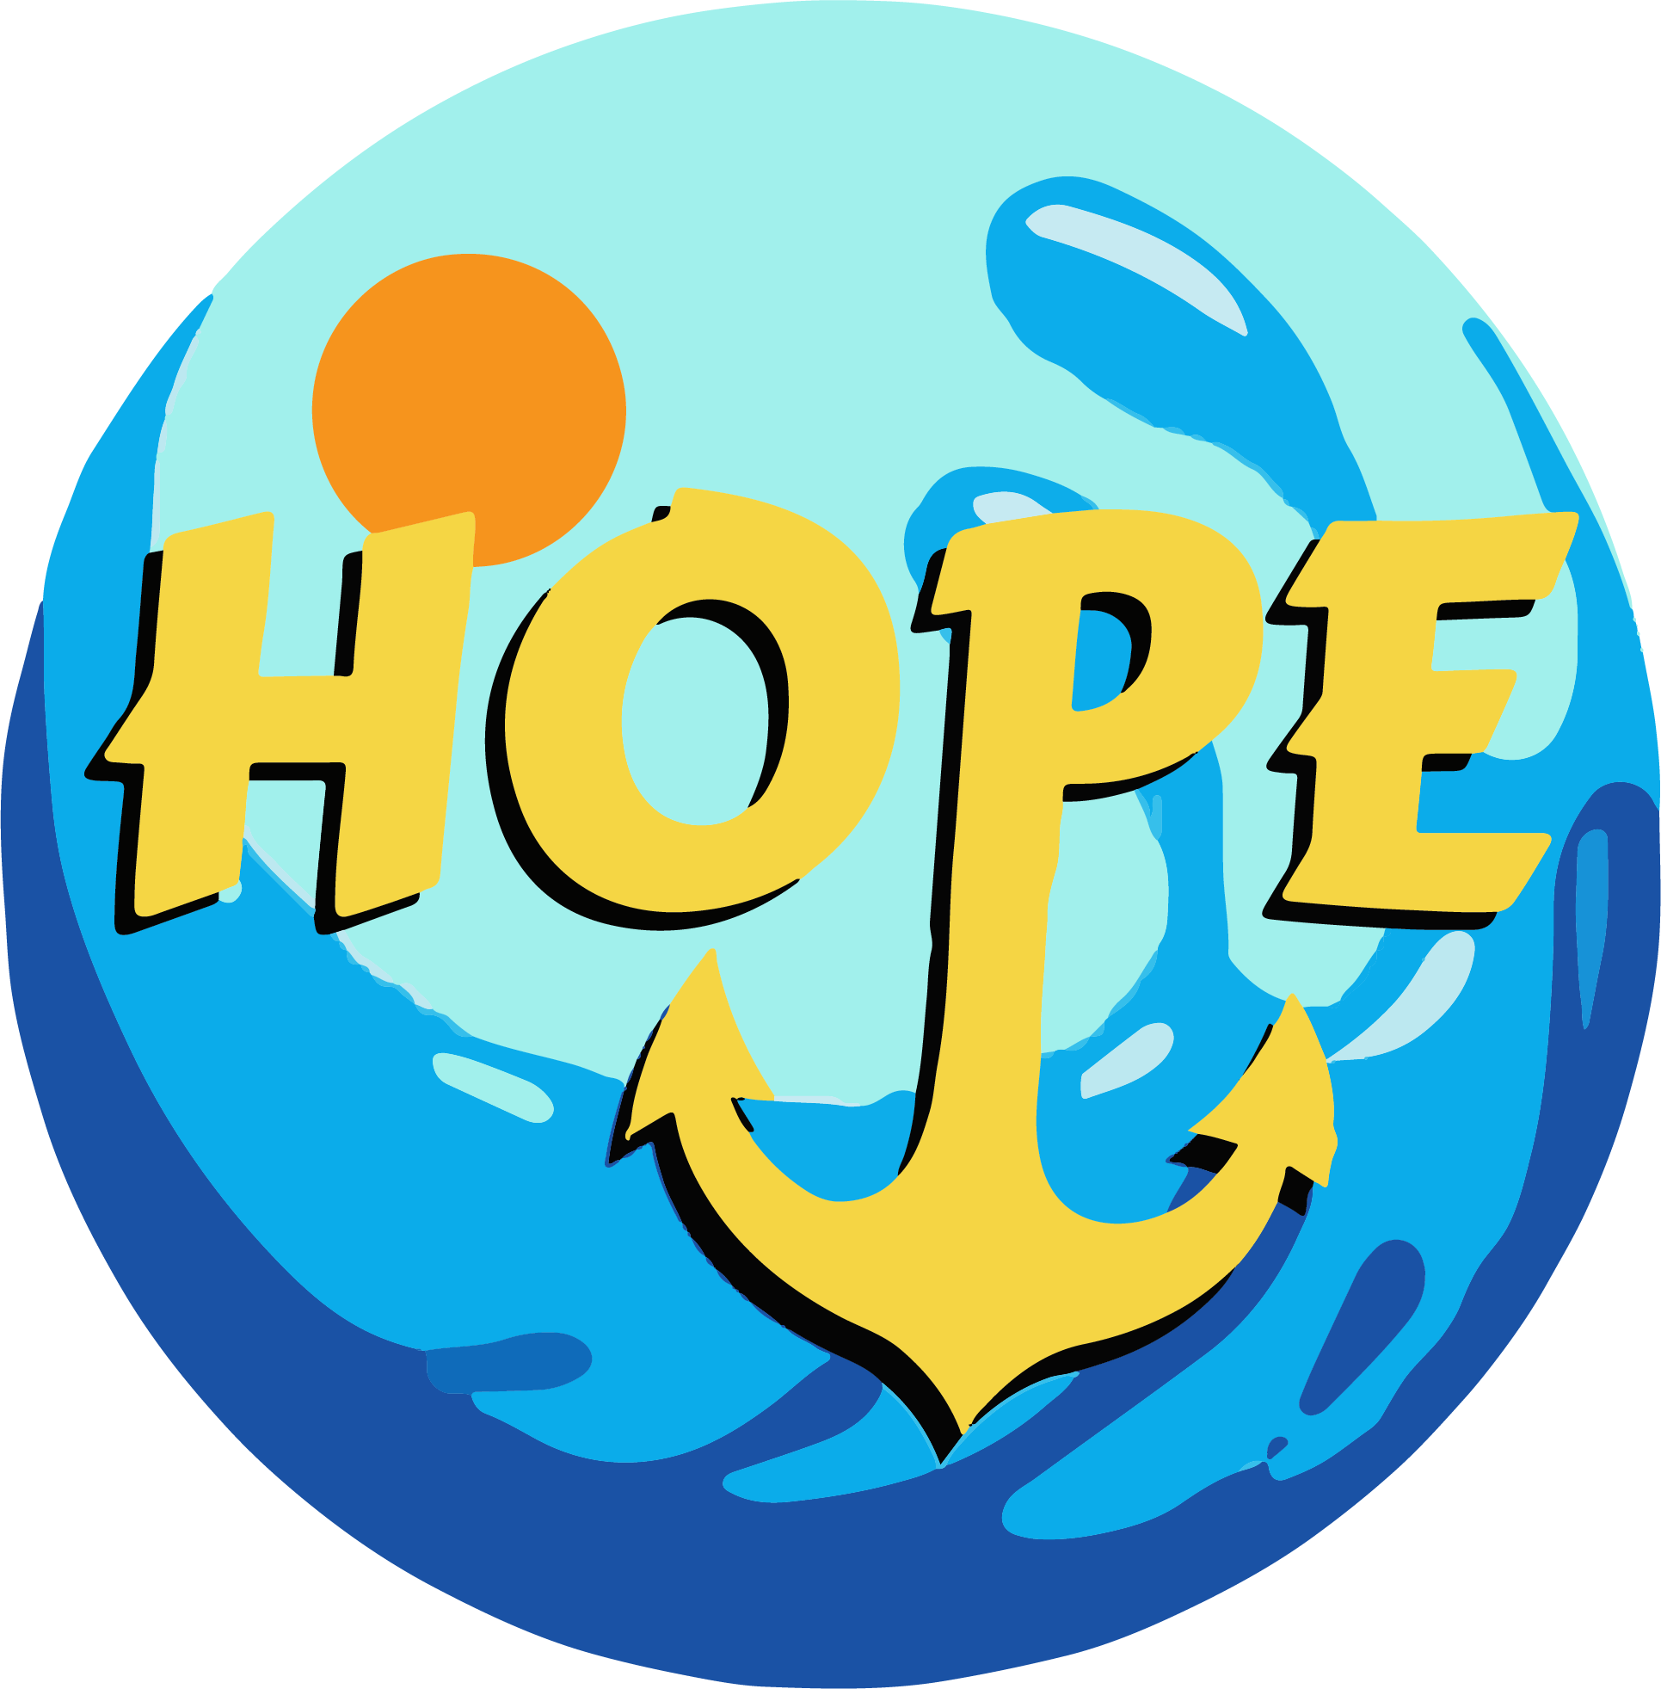
We are #1
Project Hope

Slide 3
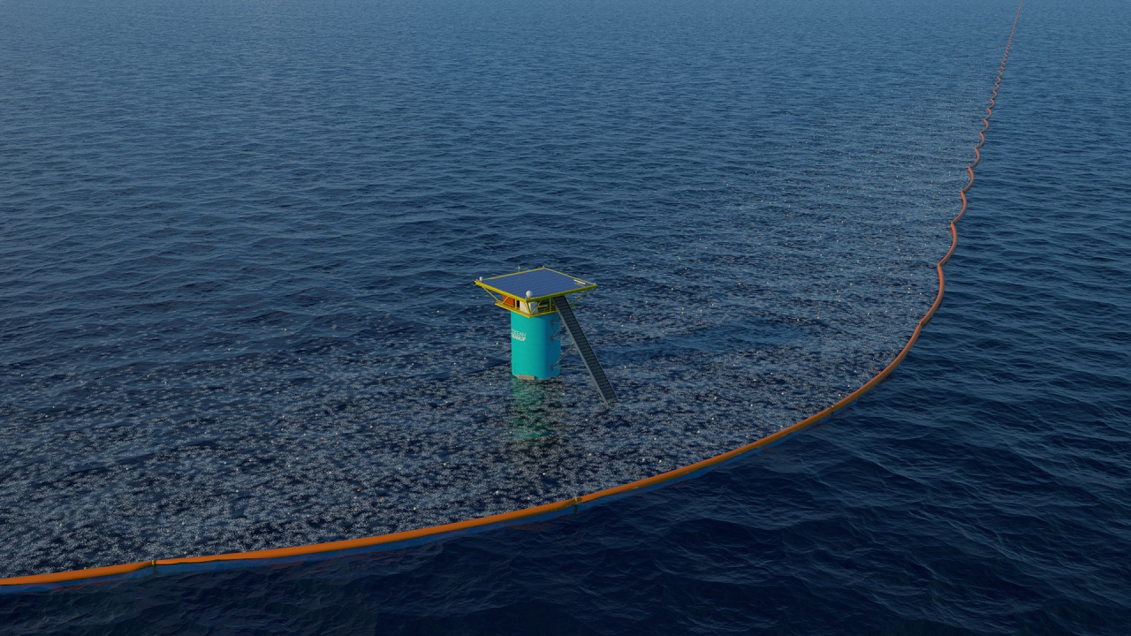

Notes:
Ocean cleanup is a Rotterdam based organization dedicated to cleaning up the great garbage patches, currently deploying in the biggest and most researched one: the north atlantic patch

Slide 4
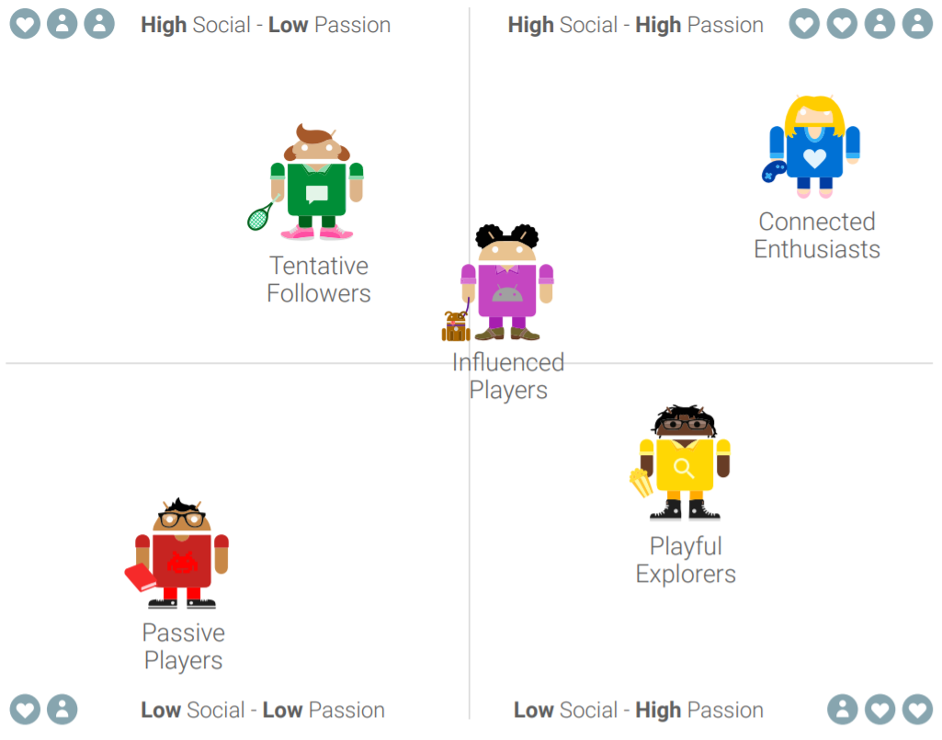
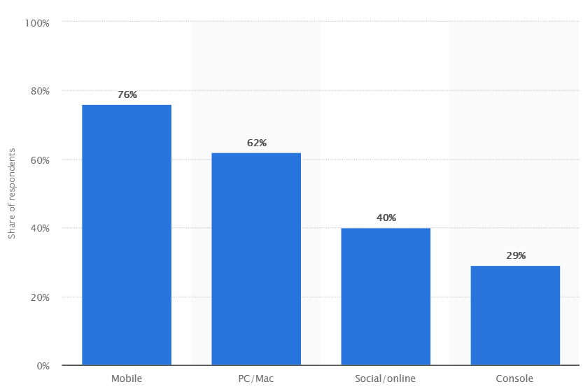
User Research

Slide 5
Last Week
This Week
VS
Game is too slow
Items to pick up are not clear
Gyroscope movement
More interesting UI elements
More variety
More feedback from the UI
Tutorial
Change the particle system

Slide 6
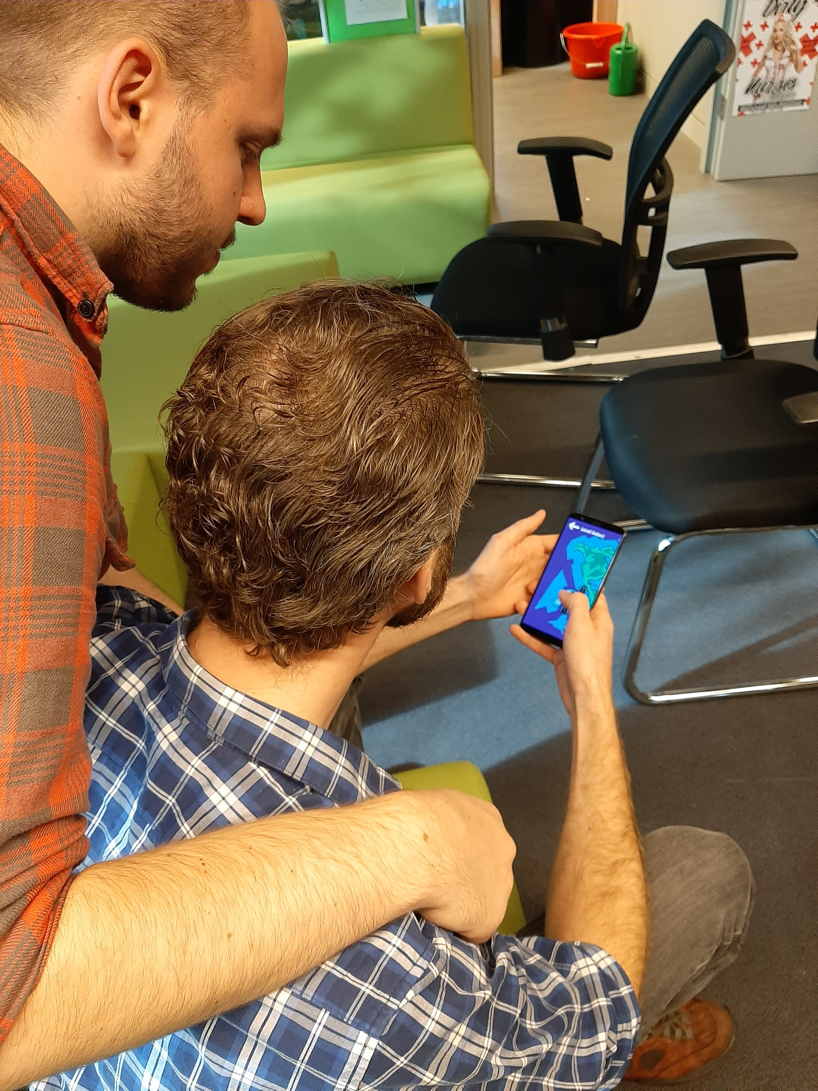
Play the game

Slide 7
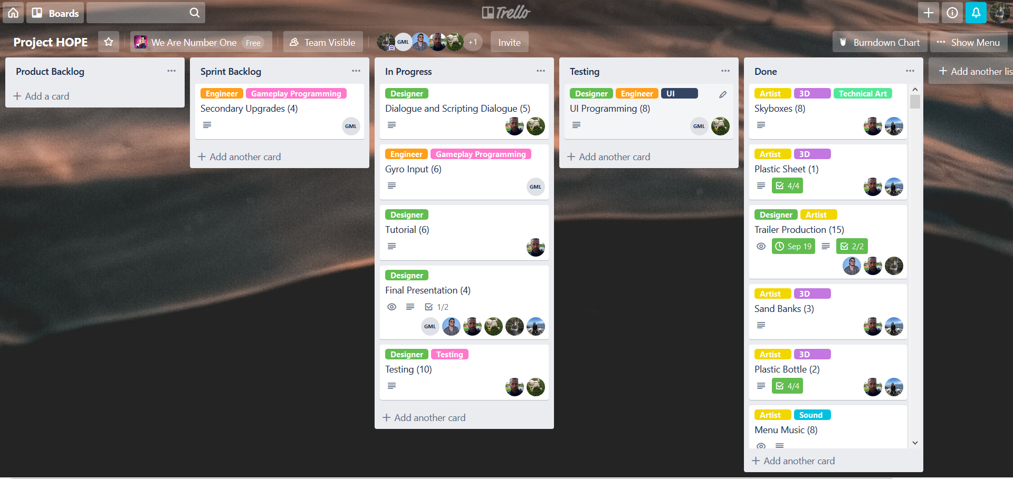
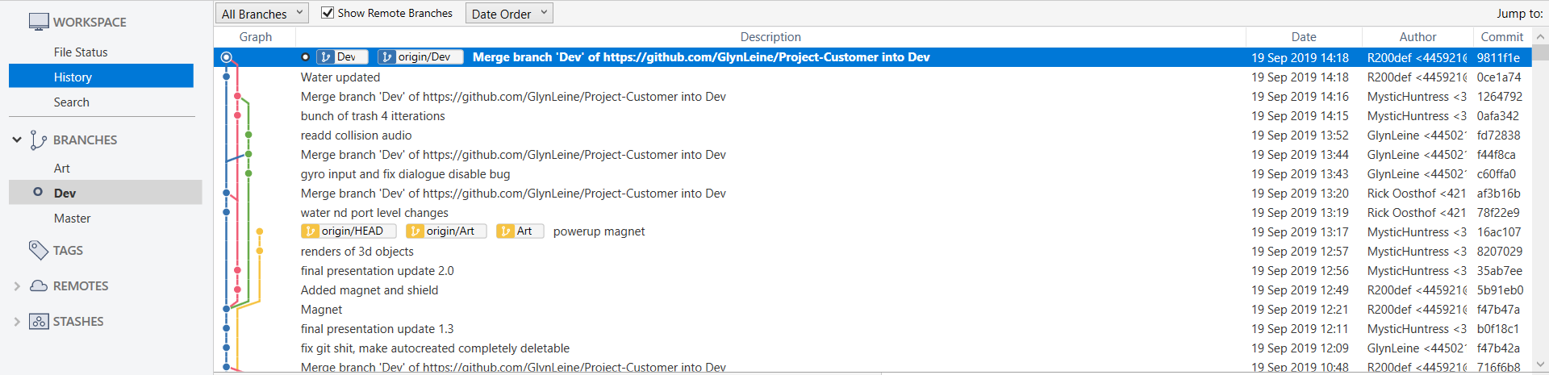
Planning
Communication
Git
Trello

Slide 8
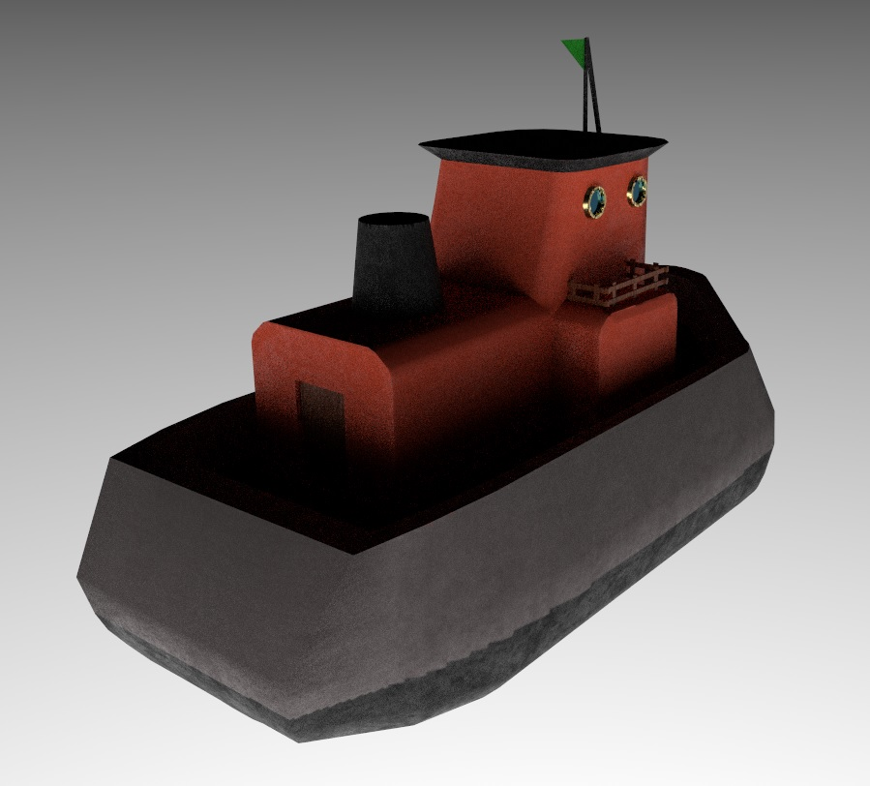
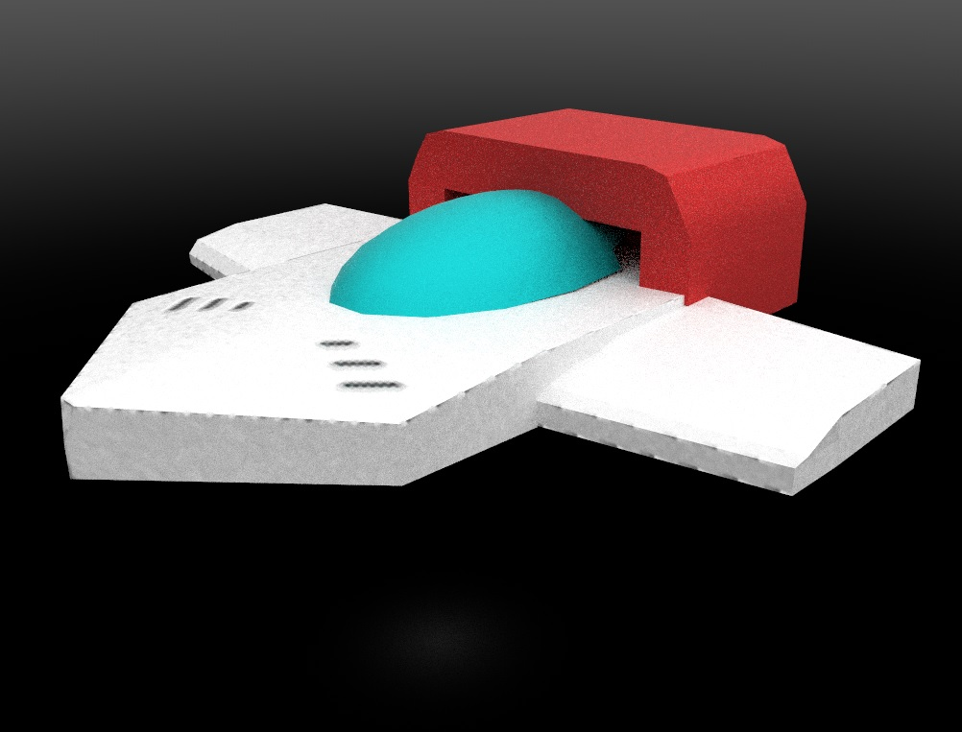
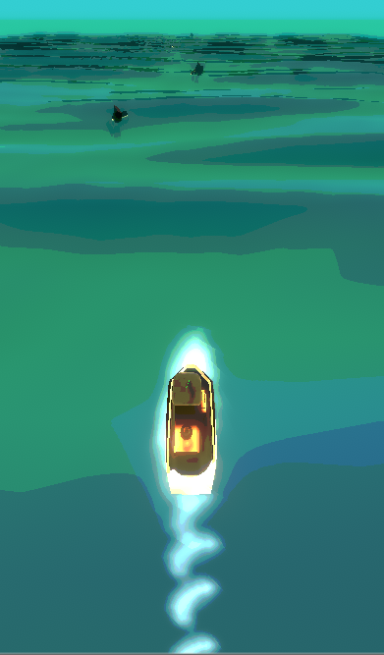
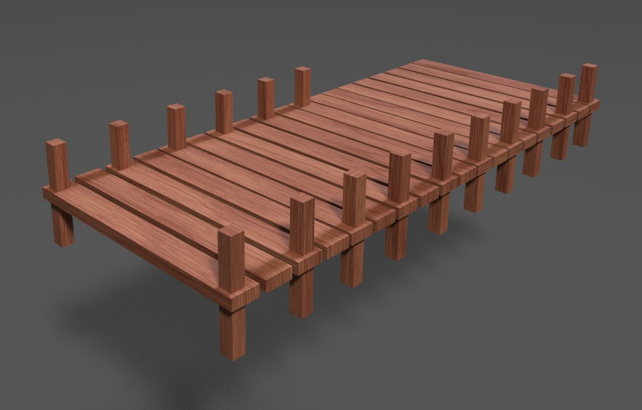
Rob Artist
Shaders
Particles
3D modeling
Project management

Slide 9





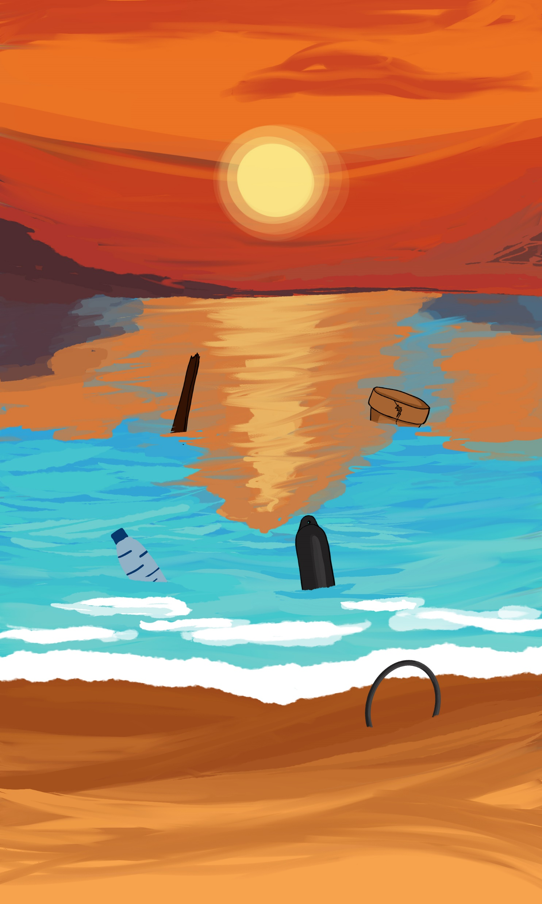

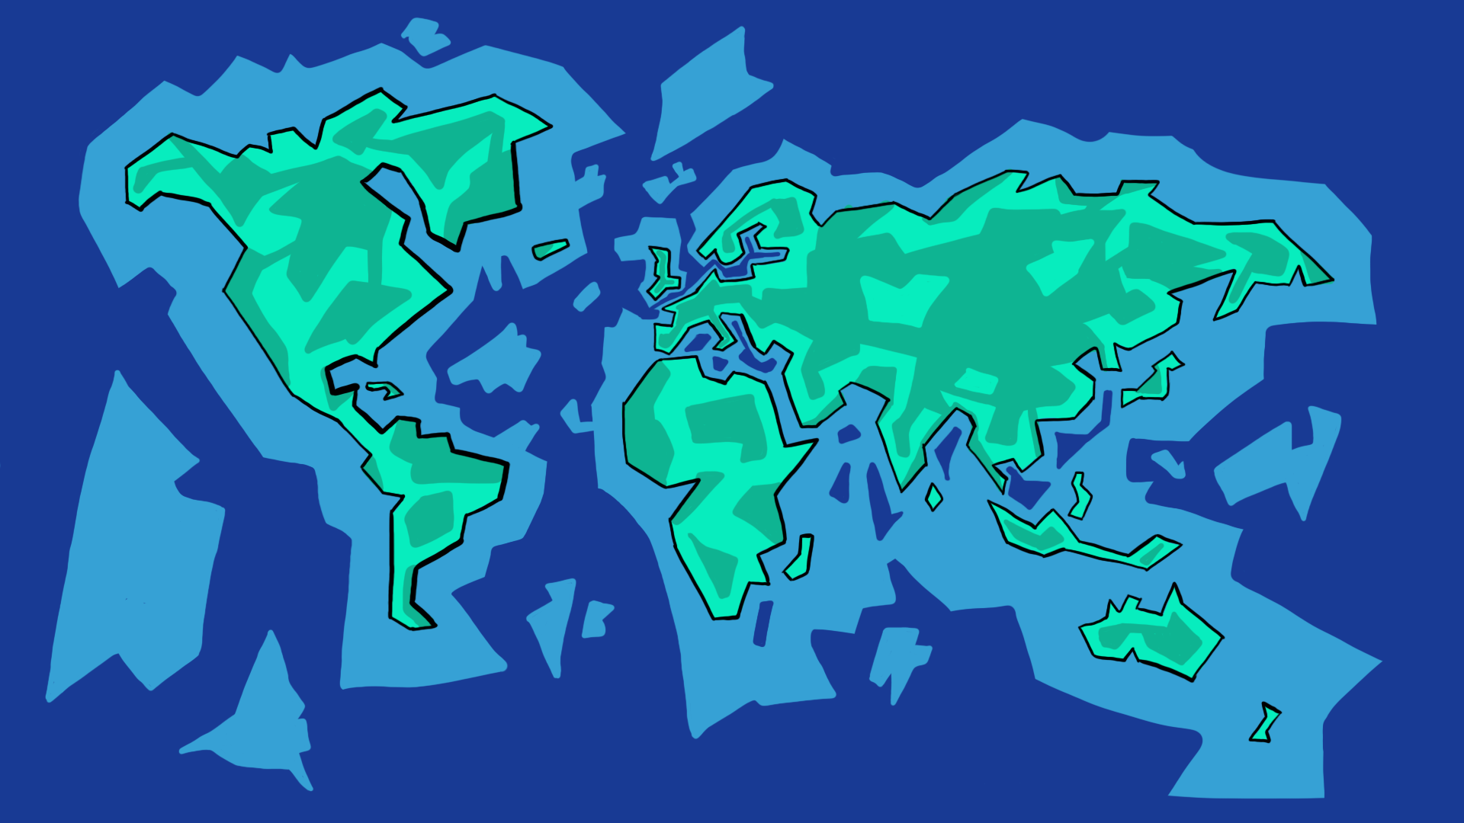
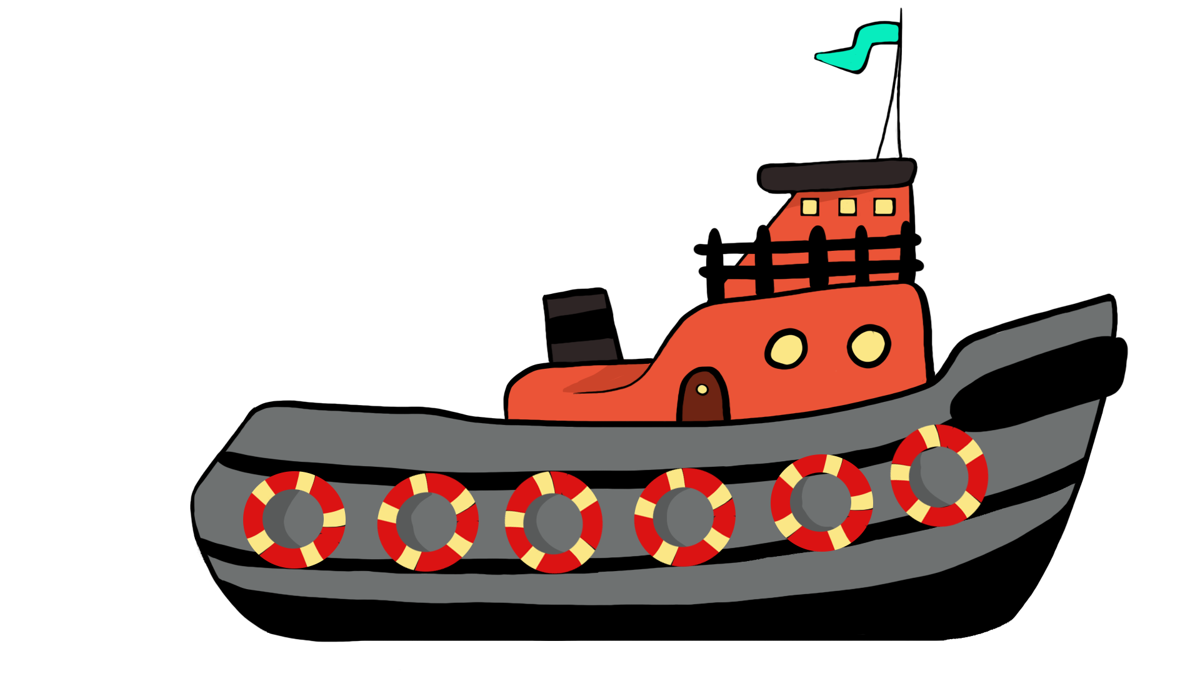
Tamara Artist
Concept art
UI art
UV-mapping and texturing
Skyboxes
Backgrounds start screen

Slide 10
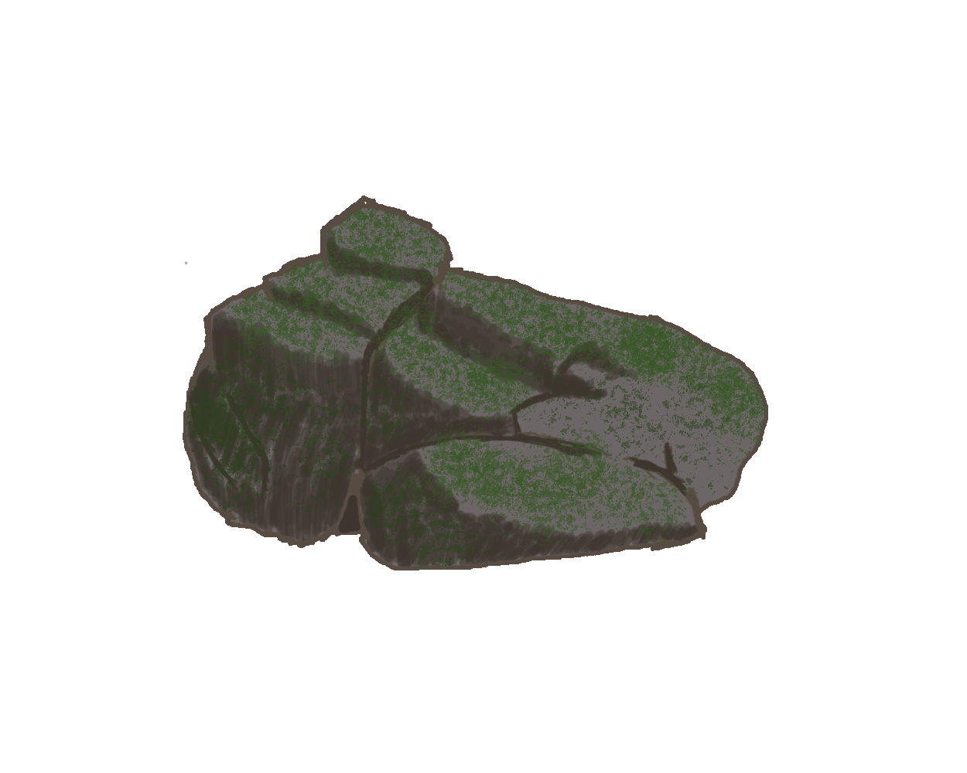


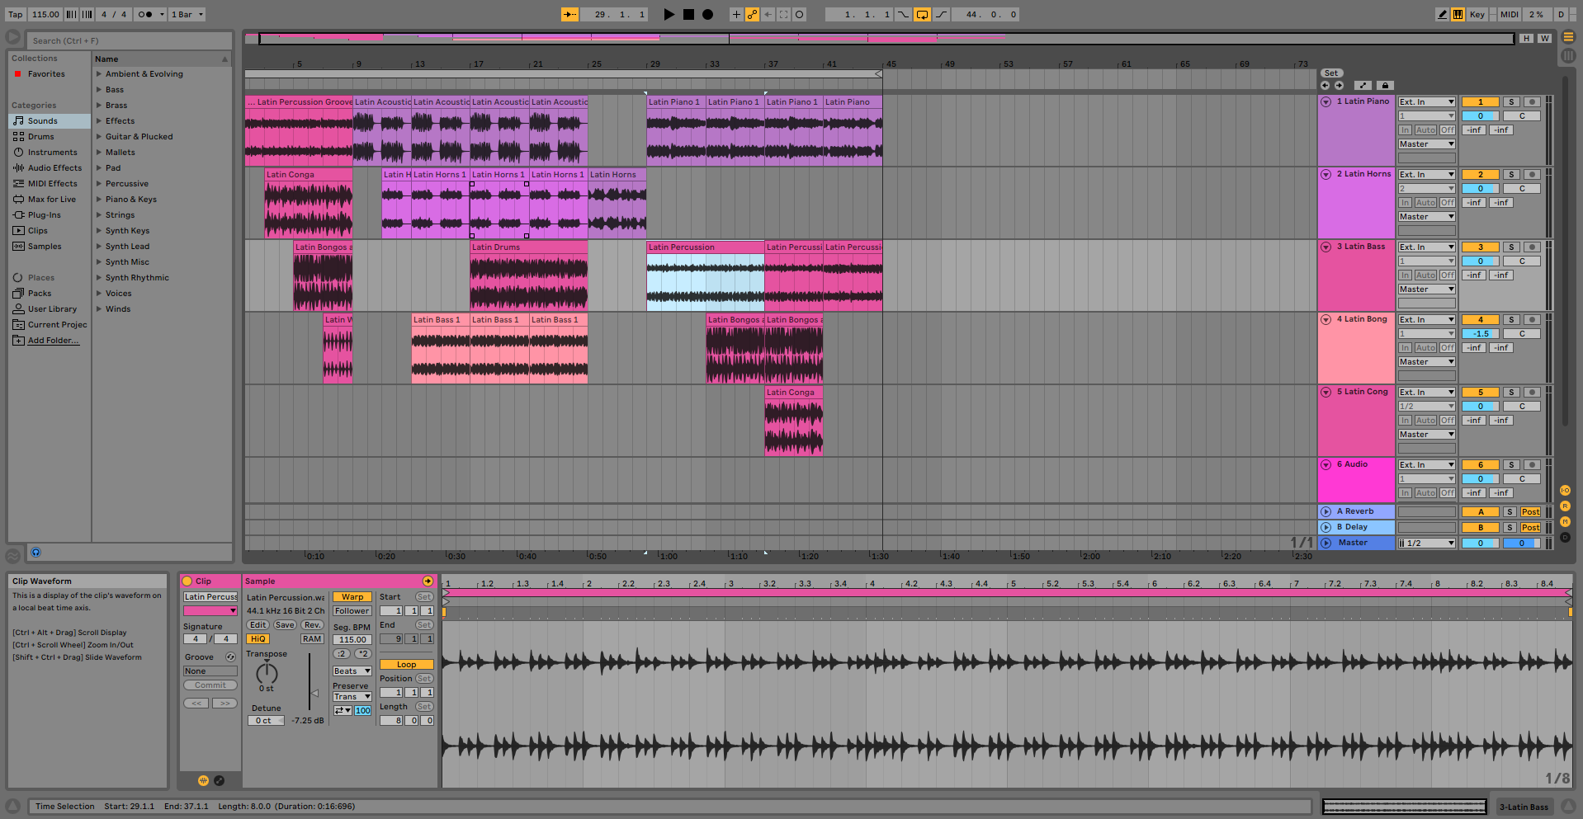
Humam Artist
Concept art
Audio sound effects
Music
UI animation

Slide 11
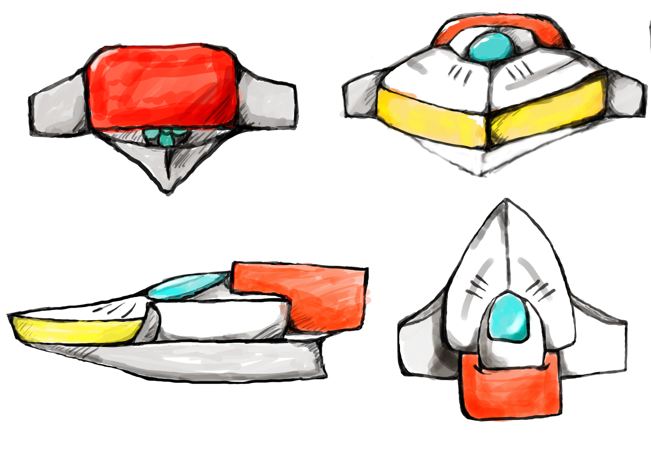
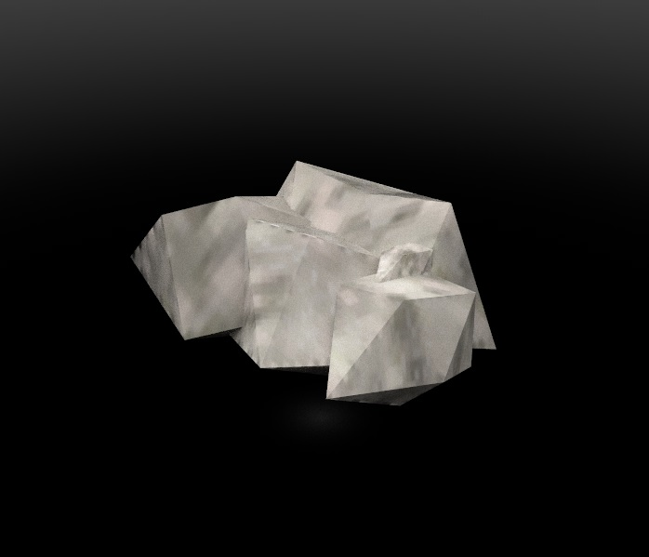
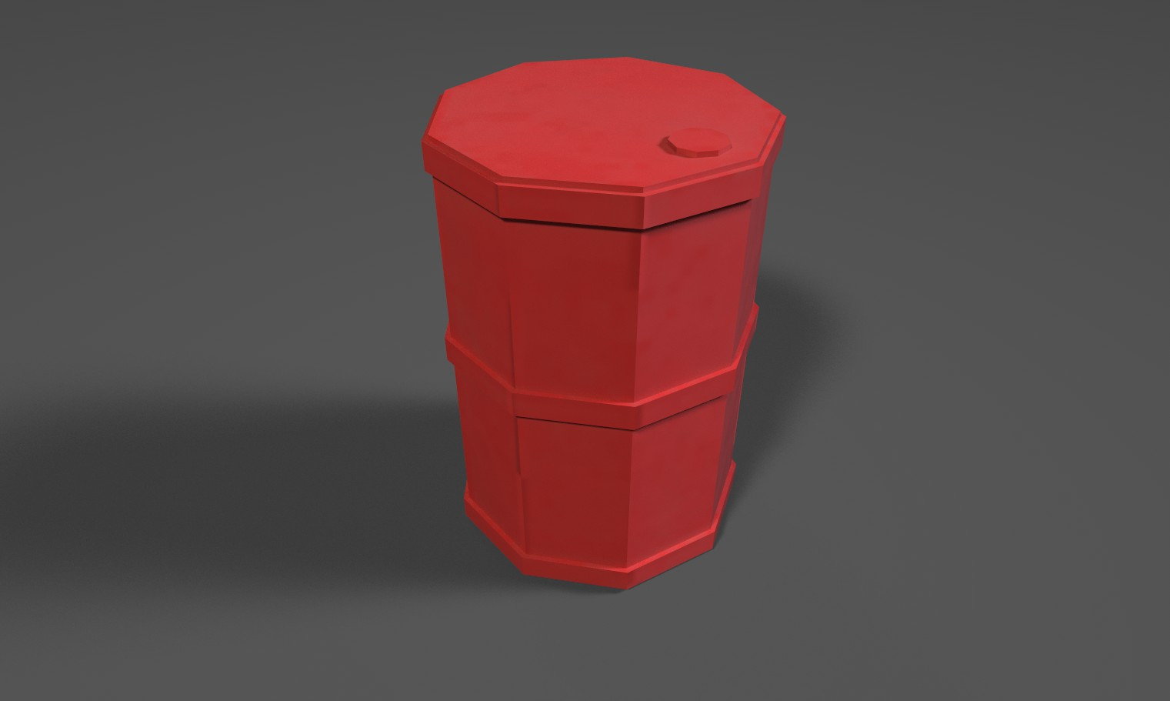
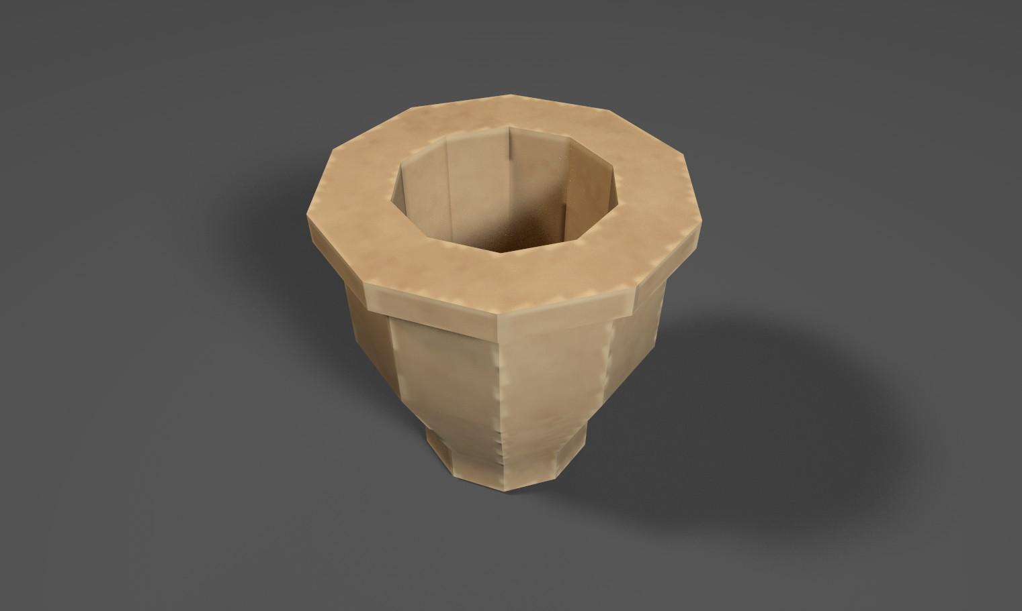
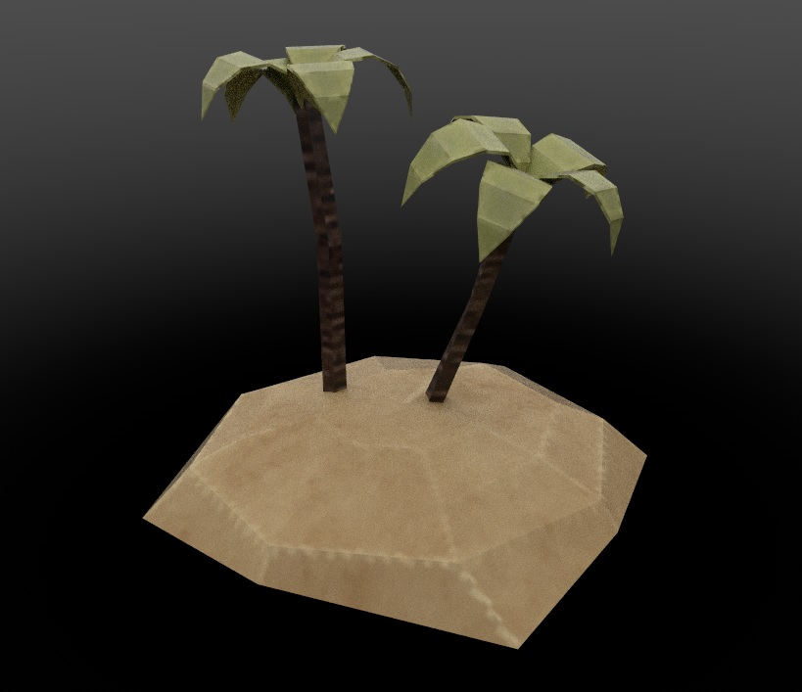
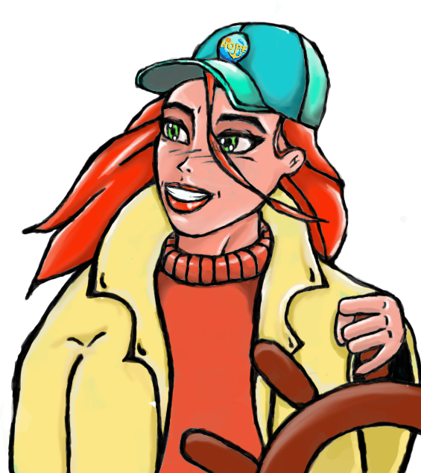
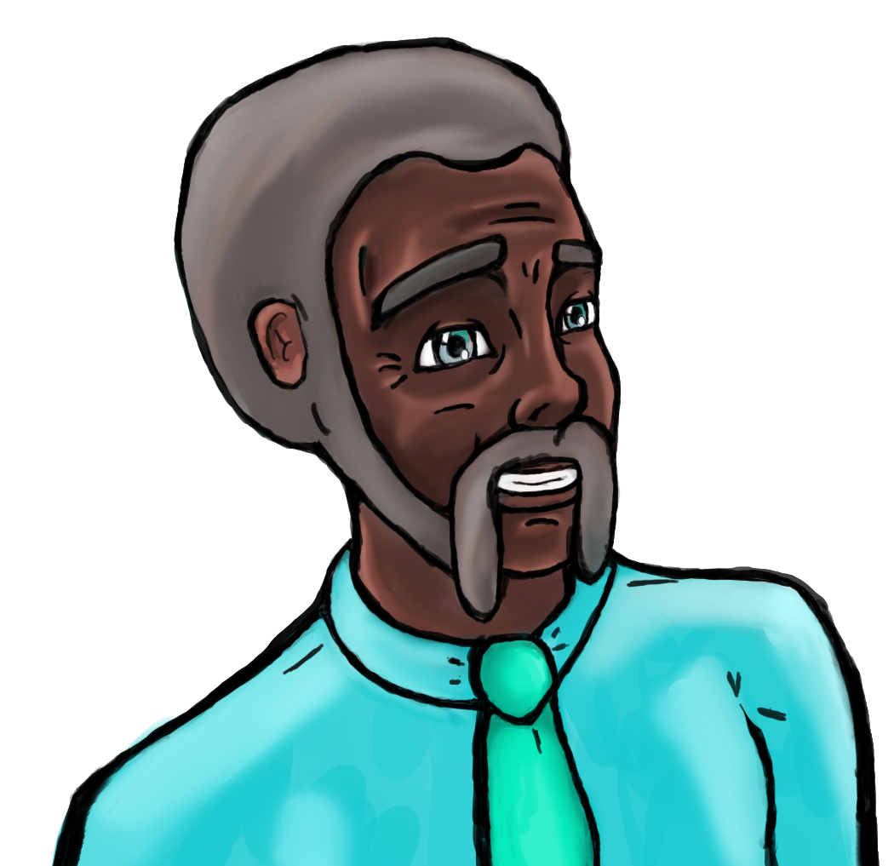
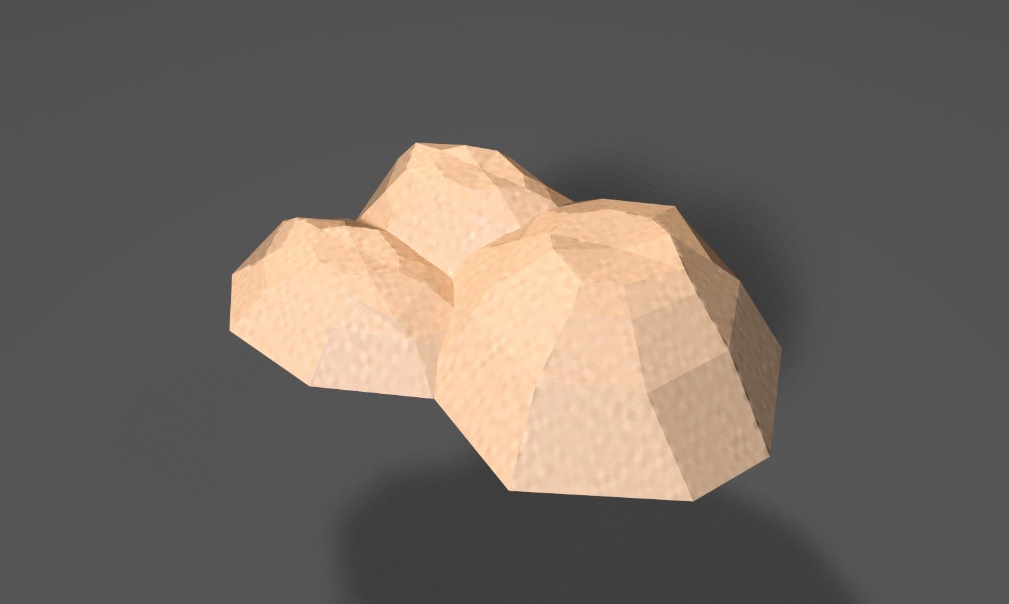
Olivier Designer/Artist
Concepting
3D models
Texturing
Character design
Dialog text

Slide 12

Concept and model

Slide 13
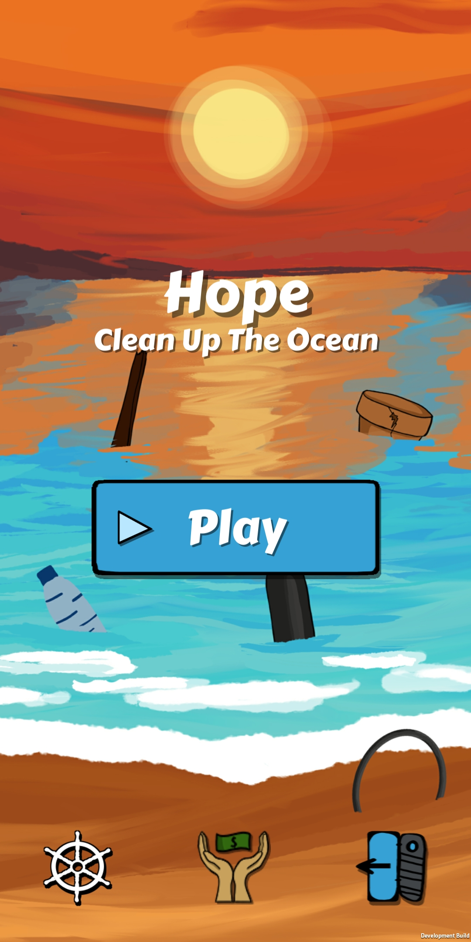

Rick Designer
Research
Game design documentation
UI design
UI programming
Audio programmer
Testing

Slide 14
Glyn Programmer
Tools
Gameplay

Slide 15
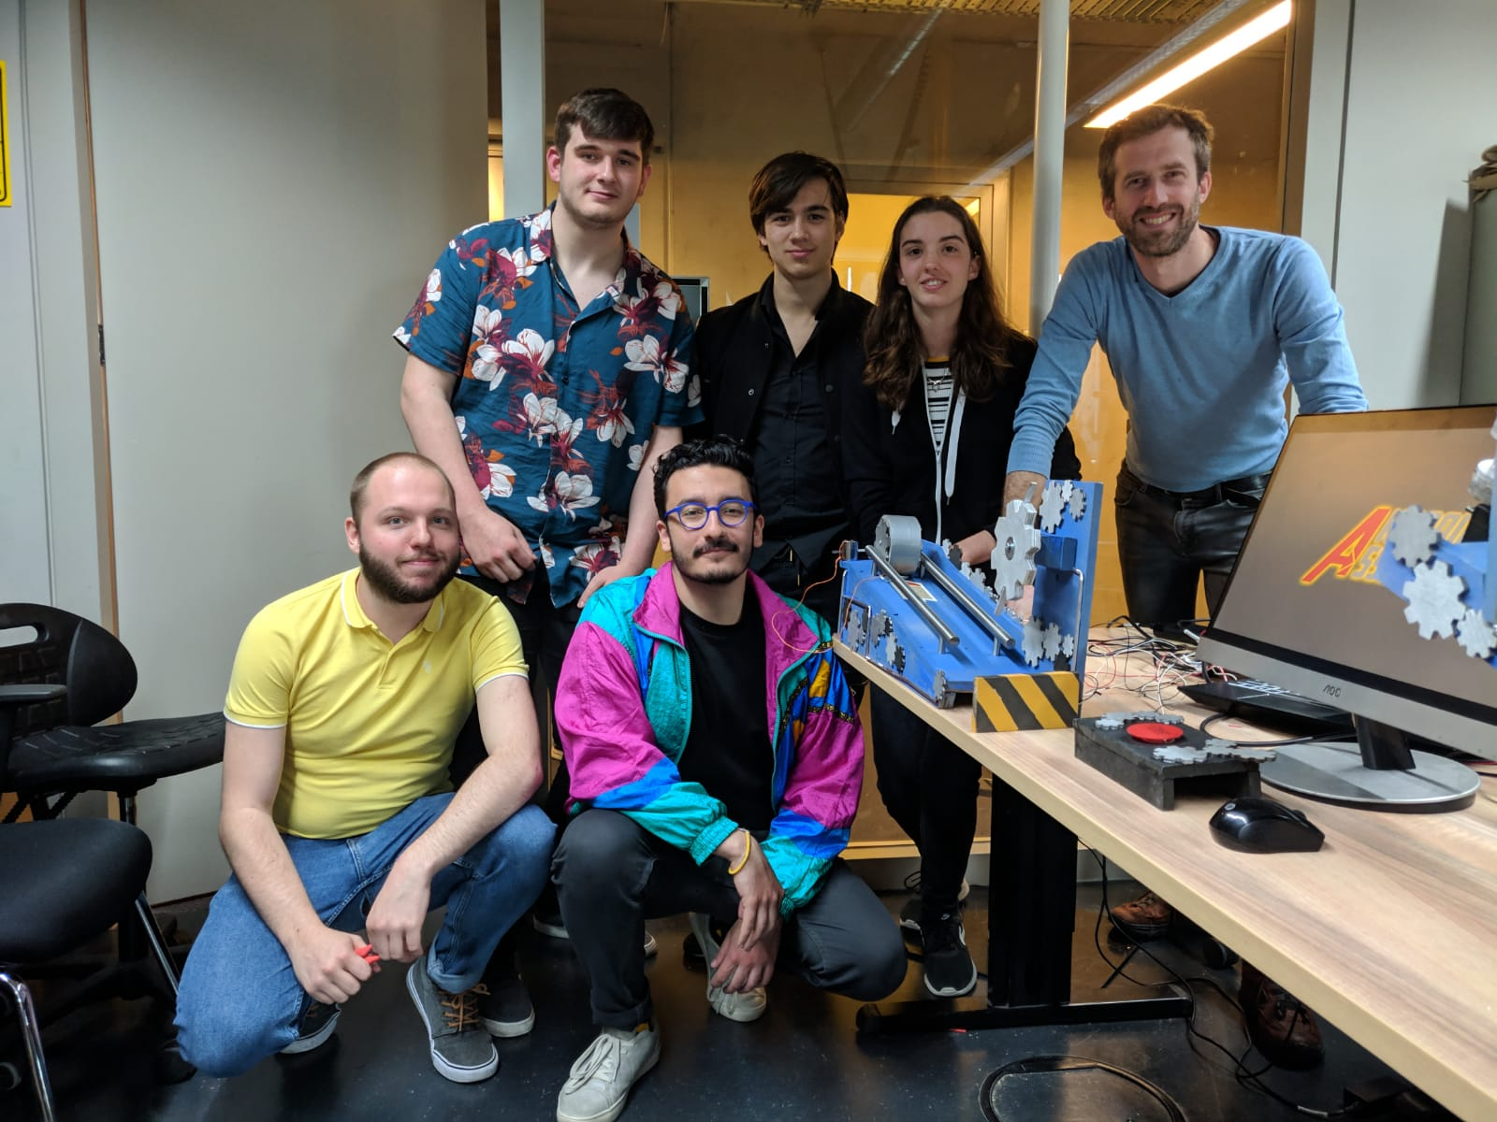
Team Reflection
What went well?
What could we improve?

Slide 16

Thank you for listening!
Any questions?

